Slide 1
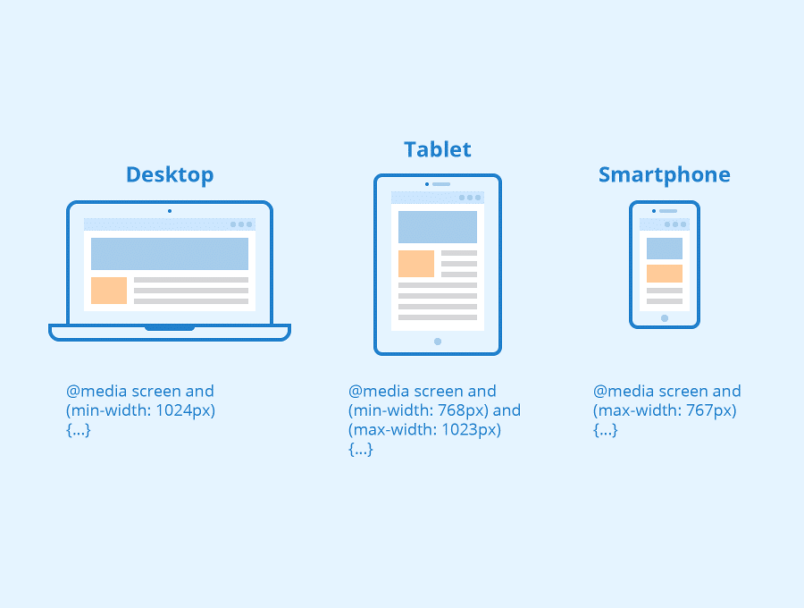


By: Brian Kemboi
Introduction Responsive Web Design?

Slide 2
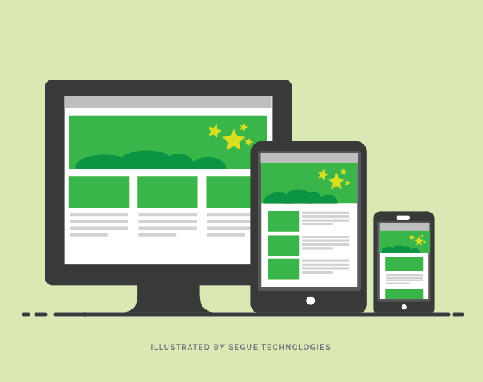
Grid
What is Responsive Web Design ?
Responsive web design makes your web page look good on all devices.
Responsive web design uses only HTML and CSS.
Responsive web design is not a program or a JavaScript.

Slide 3



Designing For The Best Experience For All Users
Web pages can be viewed using many different devices: desktops, tablets, and phones. Your web page should look good, and be easy to use, regardless of the device.
Phone
Desktop
Tablet

Slide 4
Size Content to The Viewport
Do NOT use large fixed-width elements - For example, if an image is displayed at a width wider than the viewport it can cause the viewport to scroll horizontally. Remember to adjust this content to fit within the width of the viewport.
Do NOT let the content rely on a particular viewport width to render well - Since screen dimensions and width in CSS pixels vary widely between devices, content should not rely on a particular viewport width to render well.
Use CSS media queries to apply different styling for small and large screens - Setting large absolute CSS widths for page elements will cause the element to be too wide for the viewport on a smaller device. Instead, consider using relative width values, such as width: 100%. Also, be careful of using large absolute positioning values. It may cause the element to fall outside the viewport on small devices.

Slide 5

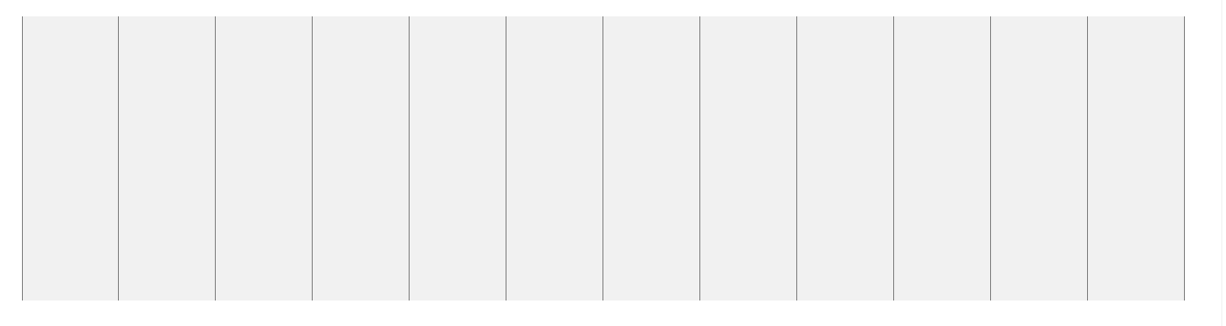
What is a Grid-View?
Using a grid-view is very helpful when designing web pages. It makes it easier to place elements on the page.

Slide 6
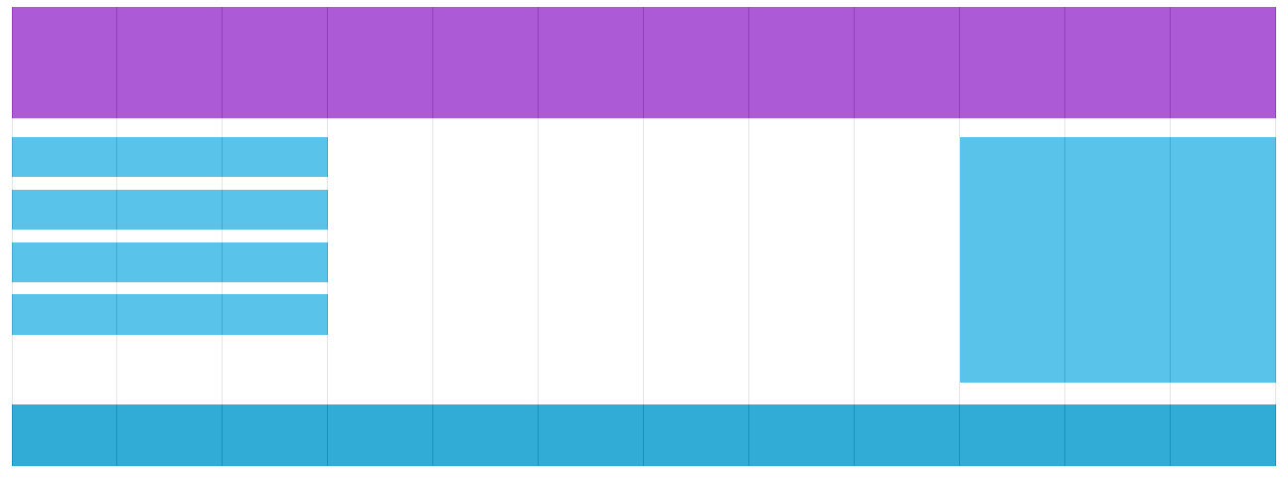
Responsive Grid
A responsive grid-view often has 12 columns, and has a total width of 100%, and will shrink and expand as you resize the browser window

Slide 7
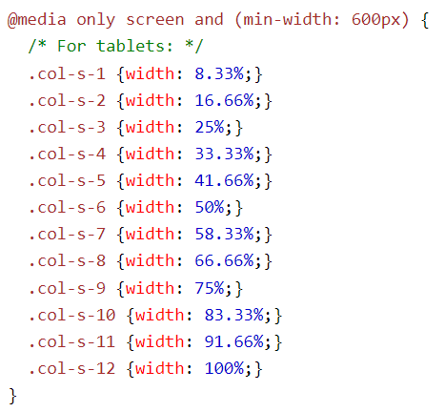
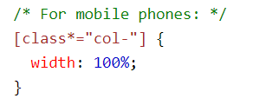
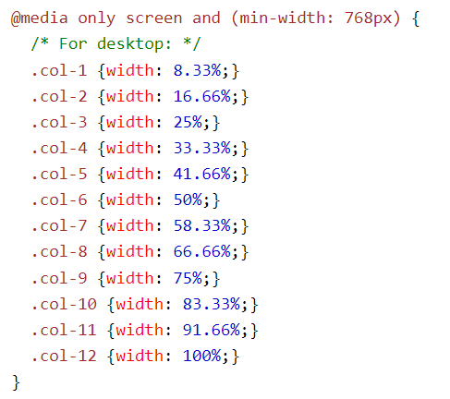
Responsive Web Design - Media Queries
Media query is a CSS technique introduced in CSS3.It uses the @media rule to include a block of CSS properties only if a certain condition is true.
Tablet
Phone
Desktop

Slide 8
Responsive Web Design - Images
Using The width Property
If the width property is set to a percentage and the height property is set to "auto", the image will be responsive and scale up and down:
Using The max-width Property
If the max-width property is set to 100%, the image will scale down if it has to, but never scale up to be larger than its original size:

Slide 9
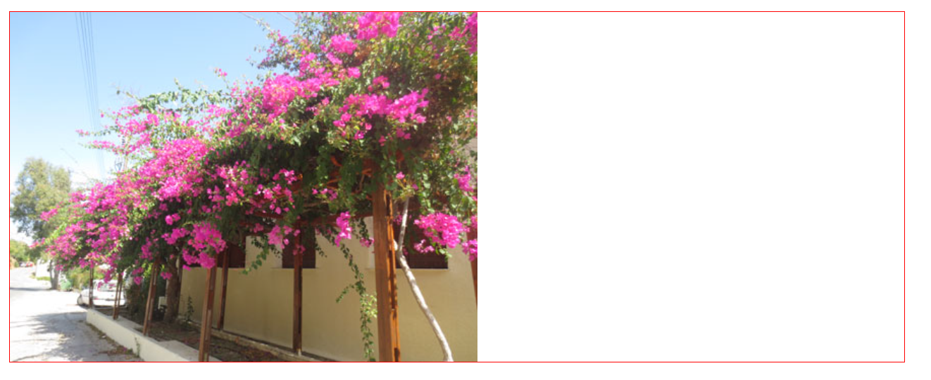
Background Images
background-size : contain
The image will scale, and try to fit the content area. However, the image will keep its aspect ratio (the proportional relationship between the image's width and height):

Slide 10
Background Images
background-size : contain
The image will scale, and try to fit the content area. However, the image will keep its aspect ratio (the proportional relationship between the image's width and height):

Slide 11
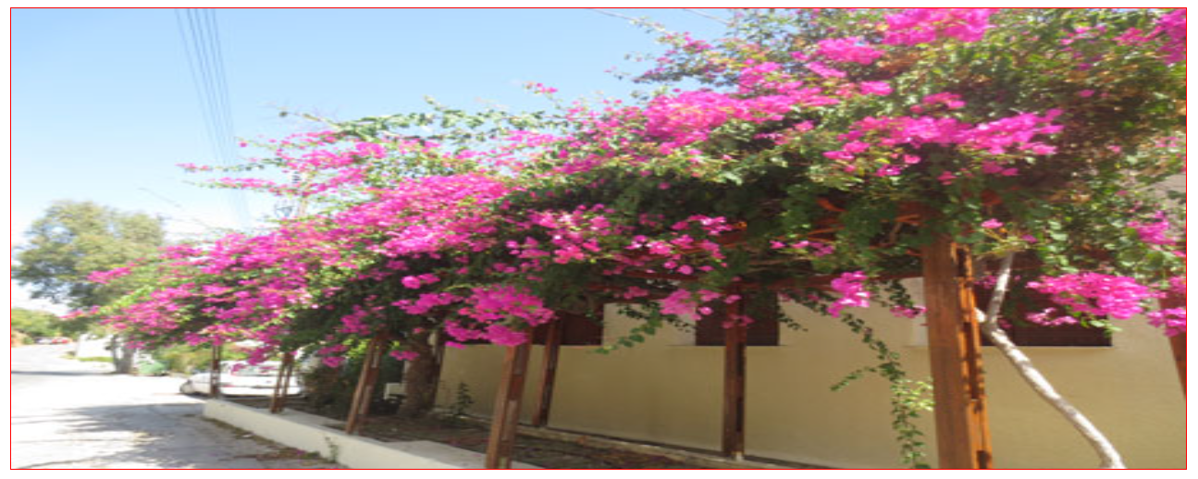
Background Images
background-size : 100% 100%
the background image will stretch to cover the entire content area:

Slide 12
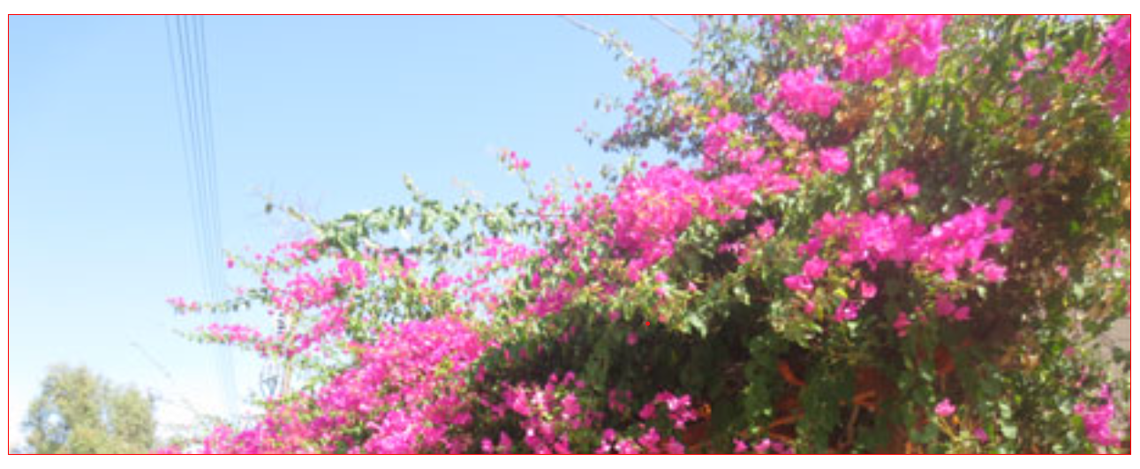
Background Images
background-size : cover
the background image will scale to cover the entire content area. Notice that the "cover" value keeps the aspect ratio, and some part of the background image may be clipped:

Slide 13
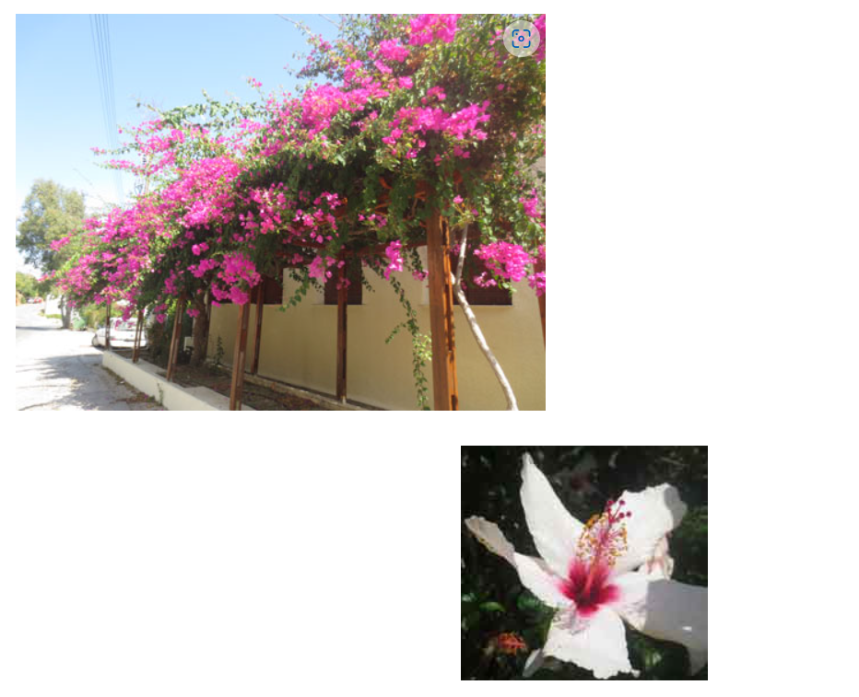
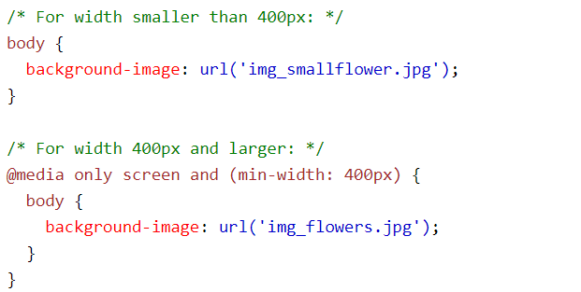
Different Images for Different Devices
background-size : cover
A large image can be perfect on a big computer screen, but useless on a small device. Why load a large image when you have to scale it down anyway? To reduce the load, or for any other reasons, you can use media queries to display different images on different devices.
Here is one large image and one smaller image that will be displayed on different devices:

Slide 14
Responsive Web Design - Videos
Using The width Property
If the width property is set to 100%, the video player will be responsive and scale up and down:
video { width: 100%; height: auto; }
Using The max-width Property
If the max-width property is set to 100%, the video player will scale down if it has to, but never scale up to be larger than its original size:
video { max-width: 100%; height: auto; }

Slide 15
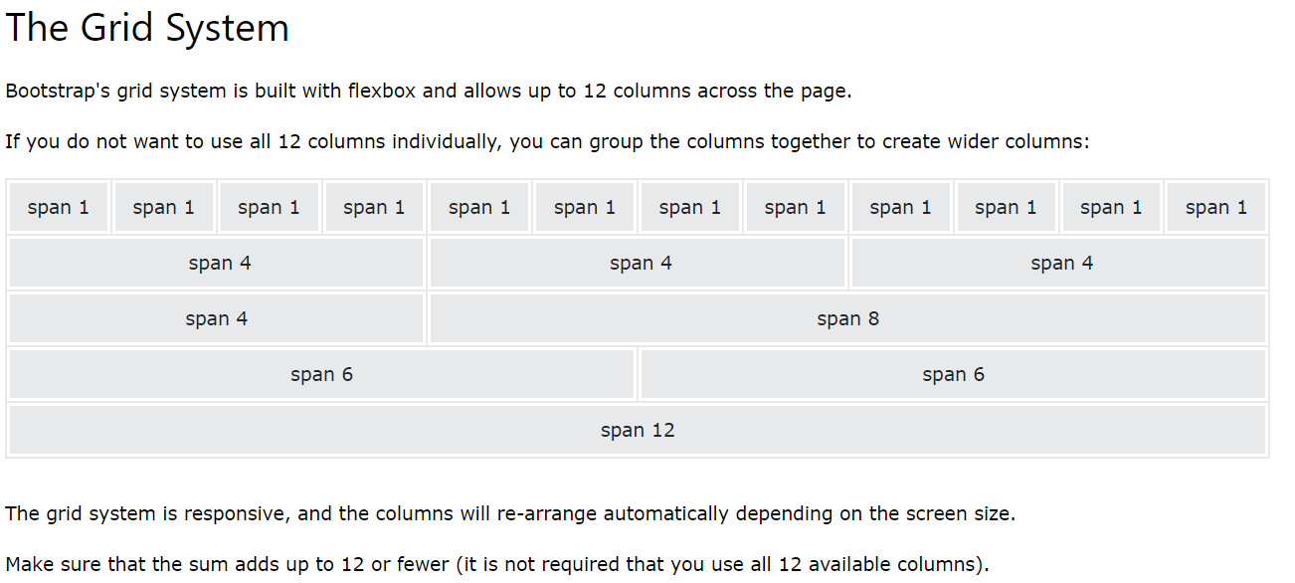
Responsive Web Design - Frameworks
Using Bootstrap

Slide 16
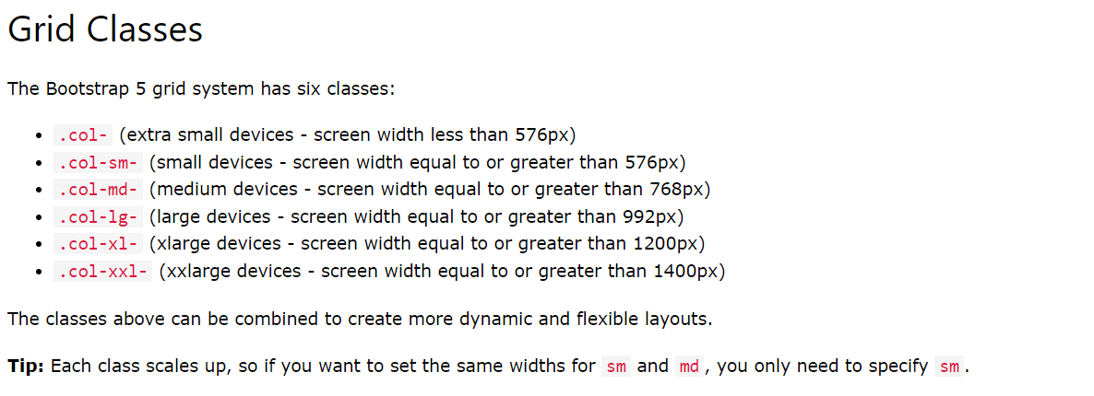
Responsive Web Design - Frameworks
Using Bootstrap

Slide 17
Flexbox
😂Like grraah, keep it a stack😂
END OF PRESENTATION

